Slide 1
Power Outage Insights: Feature Engineering in Time Series Analysis
1. Sravani Katlaganti (11560617)
2. Panduga Raja Tejasvi Prasad (11414926)
3. Yasmeen Haleem (11462753)
4. Varun Mohan (11615500)

Slide 2
Introduction
Data Integration: Combine power outage and weather data for Lee and Miami counties, Florida (2018-2022).
Feature Engineering: Utilize time-based features, rolling statistics, and lag analysis.
Modeling Techniques: Employ ARIMA, SARIMA, Linear Regression, XGBoost, ARIMAX, CatBoost Regressor, SVM and LSTM models.
Performance Metrics: Assess models using RMSE, MAE, and R².
Practical Insights: Aid in improving power outage prediction and utility management.

Slide 3
Phase-1
Module | Description | Action Item | Member | %
1 | Data Preprocessing and a model | Cleaning and merging data Xgboost model Coding and Documentation | Varun Mohan | 5 5 5 5 5
2 | Time Series Feature Engineering and a model | Time series analysis SARIMA model Coding and Documentation | Panduga Raja Tejasvi Prasad | 5 5 5 5 5
3 | Data Visualization and a model | Data Visualization ARIMA model Coding and Documentation | Yasmeen Haleem | 5 5 5 5 5
4 | A model and Detailed Analysis of Outage Prediction Models | Linear Regression model Result Analysis for models Coding and Documentation | Sravani Katlaganti | 5 5 5 5 5

Slide 4
Phase-2
Module | Description | Action Item | Member | %
1 | Analysis for different counties and model prediction | SVM model Coding and Documentation | Varun Mohan | 25%
2 | Other prediction models implementation and analyzing for different county | Catboost Regression model Coding and Documentation | Panduga Raja Tejasvi Prasad | 25%
3 | Modeling for different counties and model prediction | LSTM Model Coding and Documentation | Yasmeen Haleem | 25%
4 | Model prediction and Detailed Analysis of Outage Prediction Models from different models and counties | ARIMAX model Coding and Documentation | Sravani Katlaganti | 25%

Slide 5
Dataset
Eagle-I power dataset
Dataset Size: Consists of 1,689,460 rows with ‘POWER OUTAGE’ data, span over 4 years from 2018 - 2022 for each county of United States with an interval of 15 mins.
Columns:
'fips_code': Federal Information Processing Standards (FIPS) code for unique county identification.
'county': County name.
'state': State of the county.
'sum': Indicates power outage occurrences.
US Weather Events (2016 - 2022)
Dataset Size: Total events of 8.6 million. The dataset contains information about various weather events from January 2016 to December 2022.
Columns:
Event type: Type of the weather event (e.g., Fog, Rain).
Severity: Severity level of the weather event (e.g., Severe, Light).
Starttime:Timestamp indicating the start time of the weather event
Endtime :Timestamp indicating the end time of the weather event
County:County where the event occurred.
State:State where the event occurred.

Slide 6
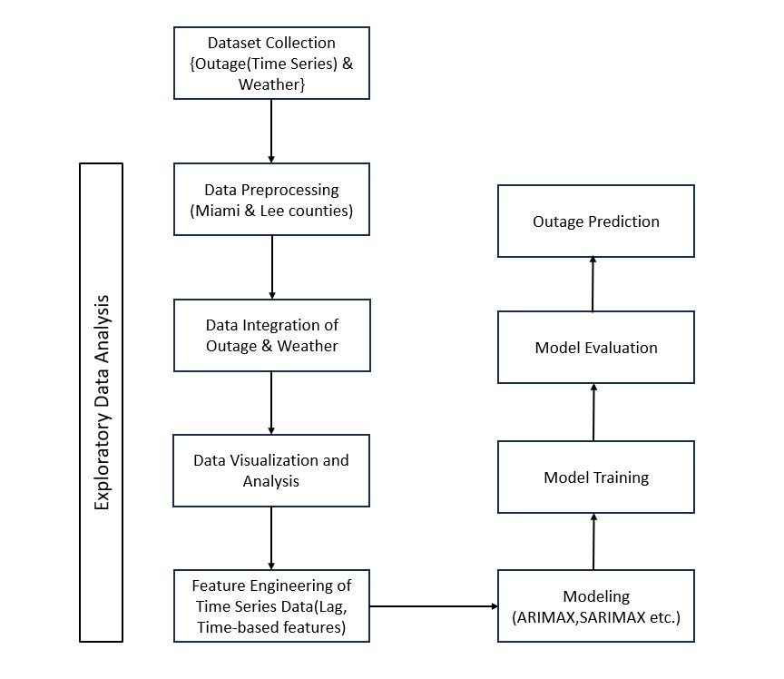
Workflow

Slide 7
Exploratory Data Analysis
Data Preprocessing of Outage Dataset:
Filtering Data
Date-Time Conversion and Manipulation
Grouping and Aggregation
Data Preprocessing of Weather Dataset:
Column Dropping
Date-Time Conversion and Localization:
Date Filtering(Drop rows for the years 2016 and 2017)
Severity Mapping
Duplicate Removal
Data Integration:
Merge the two DataFrames on their 'date'/'Date' columns using an outer join.
Handling missing values

Slide 8
Time Series Feature Engineering
Time-based features (Time based features such as Year, Month and Day)
Distribution Analysis (Rain, Fog, Cold, Precipitation, Storm, Hail)
Lag Features
Rolling Windows
Date-Time Decomposition

Slide 9
Power Outage Prediction Models
ARIMA (AutoRegressive Integrated Moving Average)
SARIMAX (Seasonal ARIMA)
Linear Regression
XGBoost (eXtreme Gradient Boosting)
ARIMAX
Catboost Regressor
SVM
LSTM

Slide 10
1. ARIMA (AutoRegressive Integrated Moving Average)
The important steps included checking for stationarity using dickey fuller test, determining ARIMA parameters (p, d, q), and fitting the model to the data.It was observed that ARIMA models are well-suited for time series data without external influences.
2. LSTM
Long Short-Term Memory (LSTM) networks are a type of Recurrent Neural Network (RNN) specifically designed to learn long-term dependencies in sequence data, which makes them highly effective for predicting power outages. They can analyze complex sequences and temporal patterns in historical power usage, weather conditions, and other relevant data to detect anomalies or conditions likely to lead to a power outage, thereby aiding in prevention and timely response.
3. XGBoost (eXtreme Gradient Boosting)
XGBoost is implementation of gradient boosting algorithms in advanced way, and is known for its efficiency, flexibility, and portability and it makes multiple decision trees sequentially, where each tree tries to correct the errors of its predecessor. This model can handle various types of data, and non-linear relationships and interactions between variables. It usually offers high predictive accuracy and is efficient on large datasets.
4. SVM
SVM regression or Support Vector Regression (SVR) is a machine learning algorithm used for regression analysis. It is different from traditional linear regression methods as it finds a hyperplane that best fits the data points in a continuous space, instead of fitting a line to the data points.

Slide 11
5. Catboost Regressor
CatBoost is a supervised machine learning method that is used by the Train Using AutoML tool and uses decision trees for classification and regression. As its name suggests, CatBoost has two main features, it works with categorical data (the Cat), and it uses gradient boosting (the Boost)
6. SARIMAX (SARIMA with eXogenous variables)
Combined the seasonal features of SARIMA with the ability to incorporate exogenous variables. It required careful selection of both seasonal and non-seasonal parameters, along with relevant external predictors.
7. ARIMAX
ARIMAX is an advanced statistical time series model that predicts future points by accounting for the past values of the variable, non-stationarity in the data, past error terms, and the influence of external or independent variables (exogenous factors) on the variable being forecasted, such as predicting power outages by including weather conditions as predictors.
8. Linear Regression
Linear Regression is statistical method used to model the relationship between a dependent variable (power outage sum) and one or more independent variables (like weather conditions).This model assumes a linear relationship between the input variables and the target.

Slide 12
CODE DEMO

Slide 13
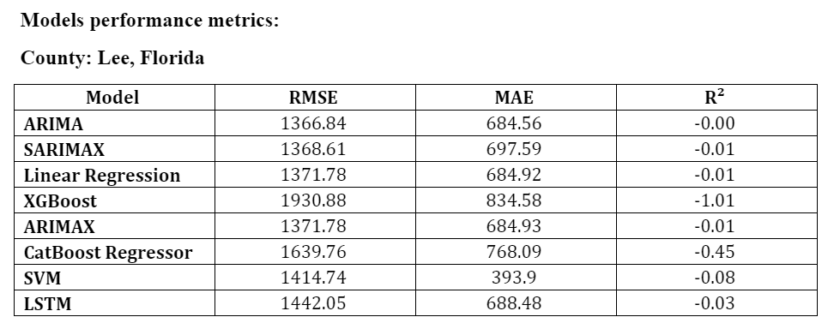
Results

Slide 14
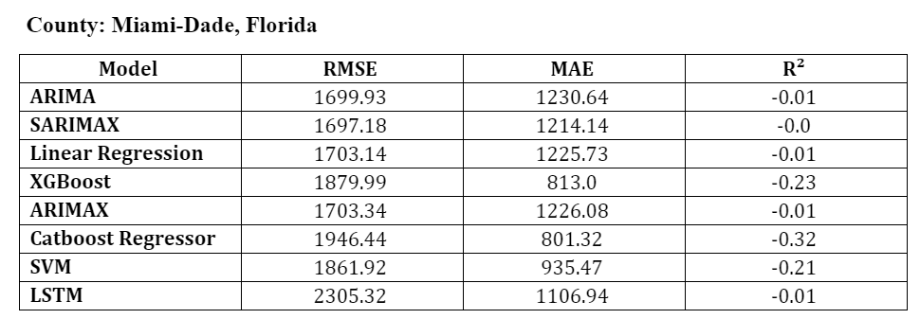
Results

Slide 15
Outage Prediction Model's Performance Analysis
The performance metrics used are:
Mean Absolute Error (MAE)
Root Mean Squared Error (RMSE)
R-Squared (R² or the coefficient of determination)
ARIMA and SARIMA balanced accuracy effectively; Linear Regression was comparable, while XGBoost and LSTM underperformed. The CatBoost Regressor showed potential overfitting with a negative R², and SVM had the best MAE, indicating accurate outage predictions.

Slide 16
Conclusion
Performed Data preprocessing, Exploratory Data Analysis and Feature Engineering.
Analyzed trends and correlation between the Outage and Weather datasets.
Models used are ARIMA, SARIMA, Linear Regressor, XGBoost, ARIMAX, Catboost Regressor, SVM, and LSTM.
Overall, ARIMA is the best performed model.

Slide 17
Thank you

